Slide 1
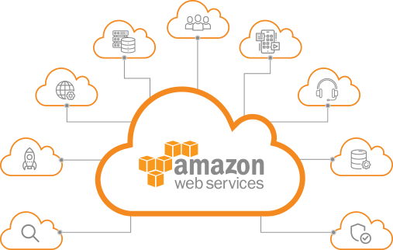
307401 Big Data
Introduction to Cloud Computing and Amazon AWS
2024-2

Slide 2

What is Cloud Computing?
Definition: Cloud computing is the on-demand delivery of IT resources over the internet with pay-as-you-go pricing.
Key Features:
Access to computing services like servers, storage, databases, networking, and software.
Available anytime, from anywhere, via the internet.
Scalable and flexible according to business needs.

Slide 3


Traditional IT vs. Cloud Computing
Feature | Traditional IT | Cloud Computing
Infrastructure | Physical hardware | Virtual infrastructure
Cost | Capital expenditure (CapEx) | Operational expenditure (OpEx)
Setup time | Weeks to months | Minutes
Scalability | Limited by physical capacity | Instantly scalable
Maintenance | Handled by in-house teams | Handled by cloud provider

Slide 4
Infrastructure as Software
In cloud computing, infrastructure (servers, storage, networks) is treated as software.
Users can provision and manage resources using code or simple interfaces.
This eliminates the need to purchase and manage physical hardware.

Slide 5
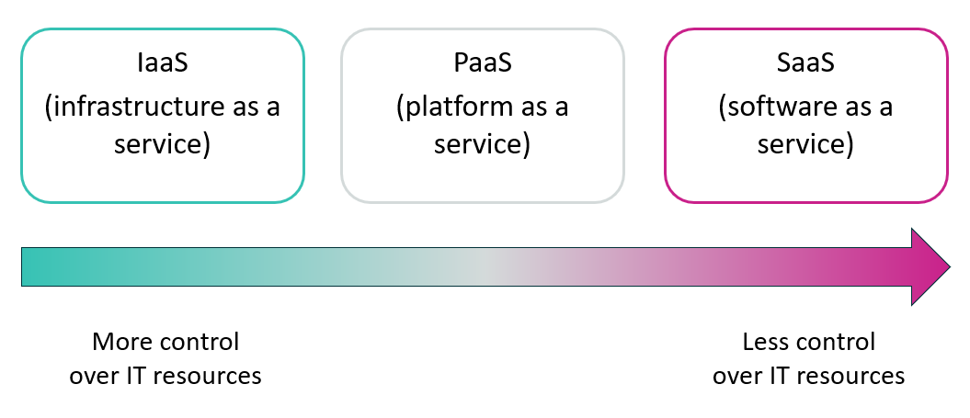
Cloud Computing Models
Three Primary Service Models:
Infrastructure as a Service (IaaS)
Provides virtualized computing resources over the internet.
Examples: Amazon EC2, Google Compute Engine
Platform as a Service (PaaS)
Provides hardware and software tools over the internet (usually for app development).
Examples: AWS Elastic Beanstalk, Google App Engine
Software as a Service (SaaS)
Delivers software applications over the internet.
Examples: Google Workspace, Microsoft 365

Slide 6

















Similarities between AWS and traditional IT
Traditional, on-premises IT space
AWS
Security
Security groups
Firewalls
ACLs
Administrators
Network ACLs
IAM
Networking
Router
Network pipeline
Switch
Elastic Load Balancing
Amazon VPC
On-premises servers
Compute
AMI
Amazon EC2 instances
Storage and database
DAS
SAN
NAS
RDBMS
Amazon EBS
Amazon EFS
Amazon S3
Amazon RDS
Notes:
There are many similarities between AWS and the traditional, on-premises IT space:
AWS security groups, network access control lists (network ACLs), and AWS Identity and Access Management (IAM) are similar to firewalls, access control lists (ACLs), and administrators.
Elastic Load Balancing and Amazon Virtual Private Cloud (Amazon VPC) are similar to routers, network pipelines, and switches.
Amazon Machine Images (AMIs) and Amazon Elastic Compute Cloud (Amazon EC2) instances are similar to on-premises servers.
Amazon Elastic Block Store (Amazon EBS), Amazon Elastic File System (Amazon EFS), Amazon Simple Storage Service (Amazon S3), and Amazon Relational Database Service (Amazon RDS) are similar to direct attached storage (DAS), storage area networks (SAN), network attached storage (NAS), and a relational database management service (RDBMS).
With AWS services and features, you can do almost everything that you would want to do with a traditional data center.

Slide 7
Cloud Deployment Models
Public Cloud
Services delivered over the public internet, available to anyone.
Example: AWS, Azure
Private Cloud
Services maintained on a private network for a single organization.
Hybrid Cloud
Combines public and private clouds, allowing data and apps to move between them.

Slide 8
Benefits of Cloud Computing
Cost Efficiency: Pay only for what you use.
Scalability: Instantly adjust resources to meet demand.
Agility: Deploy applications and services rapidly.
Global Reach: Deliver services worldwide with minimal latency.
No Maintenance: Cloud provider handles updates and maintenance.

Slide 9
Examples of Cloud Services
Category | Example Service | Description
Compute | Amazon EC2 | Virtual servers in the cloud
Storage | Amazon S3 | Scalable object storage
Database | Amazon RDS | Managed relational database service
Networking | Amazon VPC | Isolated virtual networks

Slide 10
Advantages of Cloud Computing

Slide 11
Overview
Cloud computing transforms the way organizations operate by providing a more efficient, scalable, and cost-effective approach to IT.
In this section, we will cover:
Cost transformation
Scalability and flexibility
Speed and agility
Operational efficiency
Global accessibility

Slide 12
From CapEx to OpEx
Traditional IT | Cloud Computing
High upfront costs (CapEx) | Pay-as-you-go pricing (OpEx)
Costly overprovisioning | Scale only when needed
Long procurement cycles | Instant resource provisioning
Key Benefit: You pay only for what you use, reducing waste and improving budgeting.

Slide 13
Economies of Scale
Cloud providers serve millions of customers.
This massive scale allows them to:
Purchase infrastructure at lower costs
Optimize usage of physical resources
Pass cost savings to customers
Analogy: Like buying in bulk at wholesale prices.

Slide 14
Elasticity and Scalability
Cloud platforms automatically scale resources based on demand.
Two forms of scaling:
Vertical Scaling: Increase power (CPU/RAM) of existing resources
Horizontal Scaling: Add more resources to handle load (e.g., more servers)
Result: No more guessing capacity in advance or overprovisioning.

Slide 15
Speed and Agility
Traditional IT takes weeks or months to deploy infrastructure.
Cloud computing enables deployment in minutes.
Use Case: Developers can test, deploy, and iterate quickly—reducing time-to-market.

Slide 16
Operational Efficiency
No need to manage physical data centers.
Cloud providers handle:
Power, cooling, physical security
Server maintenance and upgrades
Hardware lifecycle management
Your team can focus on innovation instead of infrastructure.

Slide 17
Global Reach
Cloud services are available across geographic regions and availability zones.
What this means for you:
Serve customers around the world with minimal latency
Comply with data residency and legal requirements
Deploy across multiple regions for resilience

Slide 18
Introduction to Amazon Web Services (AWS)

Slide 19
What is AWS?
Amazon Web Services (AWS) is a comprehensive cloud computing platform provided by Amazon.
Key Features:
Delivers on-demand access to compute, storage, databases, networking, analytics, and more.
Offers a pay-as-you-go pricing model.
Operates as a secure, global infrastructure serving millions of customers.

Slide 20
Characteristics of AWS
Secure: Data encryption, identity management, and compliance.
Flexible: Choose the right tools, platforms, and configurations.
Scalable: Instantly adapt to demand changes.
Reliable: Built-in redundancy and failover mechanisms.
Global: Data centers in multiple regions and availability zones.

Slide 21
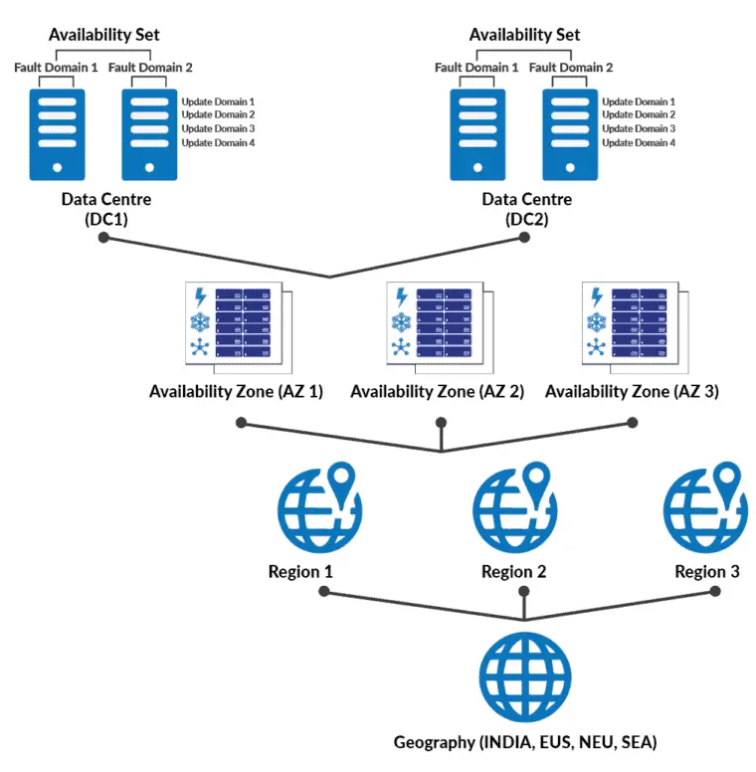
AWS Global Footprint
AWS operates in:
Regions: Geographic locations (e.g., US East, EU Central)
Availability Zones: Isolated data centers within regions
Edge Locations: For content delivery and low-latency access
Purpose for this Infrastructure:
High availability
Fault tolerance
Low latency
https://aws.amazon.com/about-aws/global-infrastructure/#AWS_Global_Infrastructure_Map
https://aws.amazon.com/about-aws/global-infrastructure/regions_az/

Slide 22
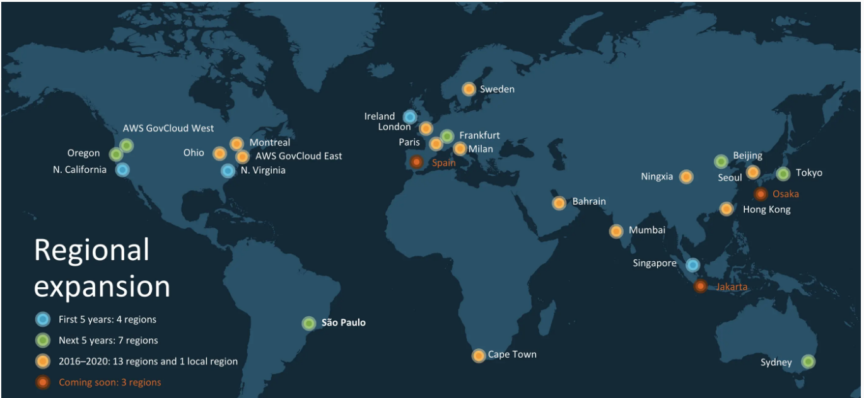
AWS Regions
Each Region is a separate geographic area.
Contains 2 or more Availability Zones.
Customers choose Regions based on:
Latency
Legal compliance
Service availability
Cost differences
Example:
Europe (Ireland) → eu-west-1
US East (N. Virginia) → us-east-1

Slide 23
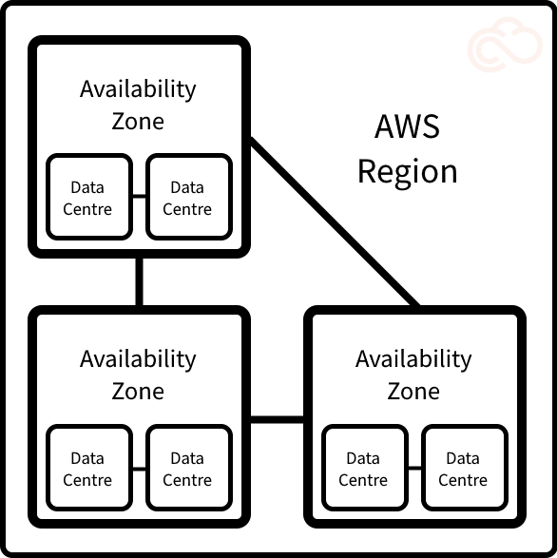
Availability Zones (AZs)
Each Region includes multiple Availability Zones.
AZs are physically isolated but interconnected using high-speed private links.
Designed for fault isolation and resiliency.
Best Practice: Deploy across multiple AZs to build highly available and disaster-resilient systems.

Slide 24


AWS Data Centers
Secure, fault-tolerant physical facilities.
Each AZ consists of one or more data centers.
Features include:
Redundant power and networking
Access controls and physical security
Environmental protections (cooling, fire suppression)

Slide 25
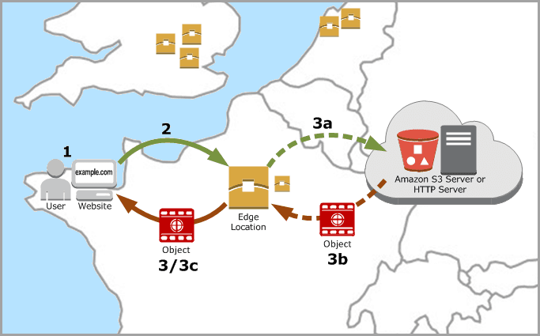
Points of Presence (PoPs)
Includes Edge Locations and Regional Edge Caches.
Used primarily for content delivery via Amazon CloudFront (CDN).
Enables fast delivery of static and dynamic content with low latency.

Slide 26
AWS Infrastructure Capabilities
Elasticity: Automatically scales based on demand.
High Availability: Ensures uptime across services.
Fault Tolerance: Isolates failures at the AZ level.
Redundancy: Multiple copies of data/services across AZs.

Slide 27
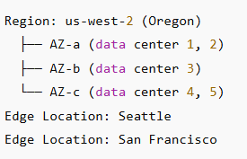
Example
This structure enables global applications with local performance.

Slide 28
AWS Service Categories

Slide 29
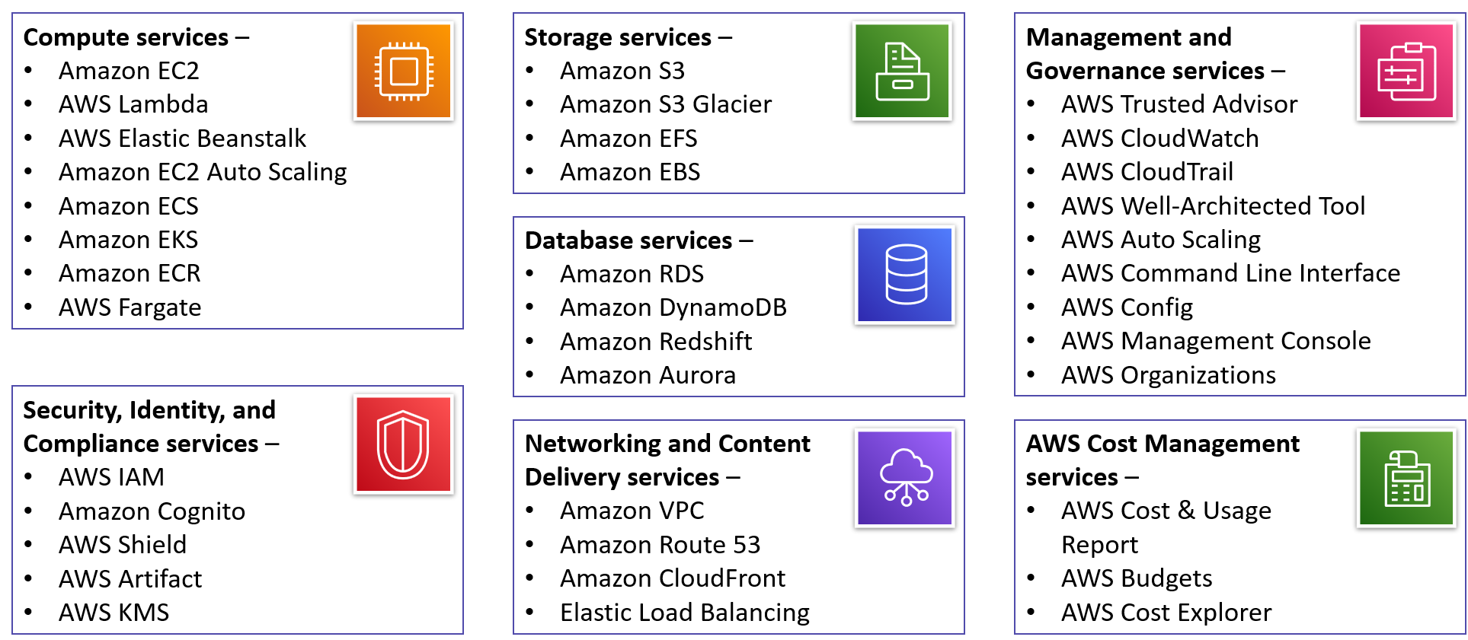
Why Organize Services into Categories?
AWS offers over 200 services.
To make it easier to find, understand, and select the right services, AWS organizes them into functional categories.
These categories reflect how businesses use cloud services to meet specific goals.

Slide 30
Core AWS Service Categories
Category | Focus Area
Compute | Virtual servers and serverless apps e.g. EC2, Lambda, Elastic Beanstalk
Storage | Data storage (object, block, file) e.g. S3, EBS, Glacier
Database | Managed SQL and NoSQL databases e.g. RDS, DynamoDB, Redshift
Networking & Content Delivery | Secure connectivity and low-latency delivery e.g. VPC, Route 53, CloudFront
Security, Identity & Compliance | Access control, encryption, and governance e.g. IAM, KMS, Shield
Management & Monitoring | Visibility, logging, and optimization e.g. CloudWatch, CloudTrail
Developer Tools | CI/CD, version control, code deployment
Analytics | Big data processing and analysis e.g. Athena, Glue, QuickSight
Machine Learning | AI/ML model training and deployment e.g. SageMaker, Rekognition

Slide 31
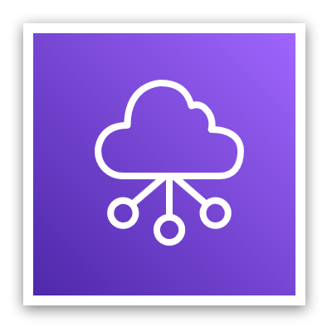

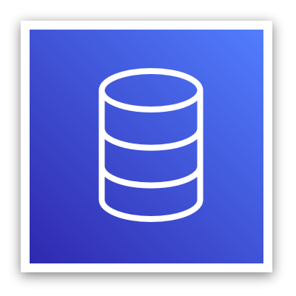






Example Use Case
A simple web application hosted on AWS:
Networking: Amazon VPC
Compute: Amazon EC2
Storage: Amazon S3
Database: Amazon DynamoDB
Security: IAM roles and policies
This modular setup shows how services integrate seamlessly.
Networking
Compute
Database
Storage
AWS Cloud
Virtual Private Cloud (VPC)
Amazon DynamoDB
Users
Amazon S3
Amazon EC2

Slide 32
Compute Services
Purpose: Deliver computing capacity in various forms
Service | Description
Amazon EC2 | Virtual servers in the cloud
AWS Lambda | Serverless functions triggered by events
AWS Elastic Beanstalk | Managed app deployment environment
Amazon ECS/EKS | Containers and Kubernetes management
AWS Fargate | Serverless containers

Slide 33
Storage Services
Purpose: Store, archive, and retrieve data efficiently
Service | Description
Amazon S3 | Scalable object storage
Amazon EBS | Block storage for EC2 instances
Amazon EFS | Elastic file storage for shared access
Amazon S3 Glacier | Archival storage with low retrieval cost

Slide 34
Database Services
Purpose: Run databases without managing infrastructure
Service | Description
Amazon RDS | Managed relational databases (e.g., MySQL, PostgreSQL)
Amazon Aurora | High-performance relational DB compatible with MySQL/PostgreSQL
Amazon DynamoDB | Managed NoSQL key-value/document store
Amazon Redshift | Data warehouse for large-scale analytics

Slide 35
Networking & Content Delivery
Purpose: Connect resources securely and deliver content globally
Service | Description
Amazon VPC | Isolated virtual networks
Route 53 | Scalable DNS and domain name routing
CloudFront | Global content delivery network (CDN)
Elastic Load Balancing | Distributes traffic to maintain performance

Slide 36
Security, Identity, and Compliance
Purpose: Protect data, manage user access, and meet compliance standards
Service | Description
AWS IAM | Identity and Access Management
AWS KMS | Key Management Service for encryption
AWS Shield | DDoS protection
AWS Artifact | Compliance and audit documentation

Slide 37
Monitoring & Management
Purpose: Improve visibility, control, and efficiency
Service | Description
Amazon CloudWatch | Monitors metrics, logs, alarms
AWS CloudTrail | Tracks user activity and API usage
AWS Config | Audits configuration changes
AWS Trusted Advisor | Optimization and best practices review

Slide 38
Developer Tools & Others
Developer Tools:
AWS CodeCommit, CodeBuild, CodeDeploy, CodePipeline
Other Categories (Examples):
Machine Learning: Amazon SageMaker, Rekognition
Analytics: Athena, Glue, QuickSight
IoT, Blockchain, Robotics, AR/VR Each with targeted services

Slide 39
AWS Cloud Security and Identity Access Management (IAM)

Slide 40
Shared Responsibility Model
AWS uses a shared responsibility model to divide security duties between AWS and the customer.
Responsibility Area | AWS (Provider) | Customer (User)
Physical security | ✓
Infrastructure (hardware, VMs) | ✓
Network configuration |  | ✓
OS, apps, and data |  | ✓
Access control and permissions |  | ✓
Summary: AWS secures the cloud itself, customers secure what they do in the cloud.

Slide 41
AWS Responsibilities
AWS is responsible for:
Securing data centers, servers, networking, and storage infrastructure.
Providing encrypted services and physical redundancy.
Maintaining hardware, hypervisors, and virtualization layers.

Slide 42
Customer Responsibilities
You (the customer) are responsible for:
Securing your applications and data.
Managing access through IAM (users, roles, groups).
Configuring firewalls (security groups) and encryption.
Regularly updating your OS, patches, and credentials.

Slide 43
Security at Different Service Levels
Cloud Model | Responsibility Level
IaaS | Customer manages OS, apps, firewalls
PaaS | Customer manages data and app logic
SaaS | Customer manages only the data and access
Example:
EC2 (IaaS) requires OS patching.
Lambda (PaaS) abstracts OS, customer only writes code.

Slide 44
What is IAM (Identity and Access Management)?
IAM is the AWS service that allows you to:
Authenticate: Who is trying to access the system.
Authorize: What they are allowed to do.
Key Functions:
Define users, groups, roles, and policies
Control access to AWS resources (e.g., S3, EC2)

Slide 45
IAM Key Concepts
Concept | Description
User | Represents a person or service needing access
Group | A collection of users with shared permissions
Role | Temporary access granted to trusted entities
Policy | A JSON document defining allowed or denied actions on resources

Slide 46
IAM Policies
Written in JSON format
Two types:
Identity-based: Attach to users, groups, or roles
Resource-based: Attach directly to resources (e.g., S3 bucket)
Example Allow Policy:
{
"Effect": "Allow",
"Action": ["s3:*"],
"Resource": "arn:aws:s3:::example-bucket/*"
}

Slide 47
Principle of Least Privilege
Always follow this best practice:
"Grant only the permissions required to perform a task, and no more.“
This minimizes security risks by limiting exposure.

Slide 48
IAM Roles – Use Cases
IAM Roles are used to:
Grant applications (e.g., EC2 instances) permission to access AWS services.
Delegate access to users in other AWS accounts.
Enable temporary access with conditions (e.g., session duration).

Slide 49
AWS Compute Services

Slide 50
What is Compute in Cloud Computing?
"Compute" refers to the processing power required to run applications, systems, and workloads.
AWS provides flexible options:
Virtual machines (EC2)
Serverless functions (Lambda)
Containers (ECS, EKS)
Platform-as-a-Service (Elastic Beanstalk)

Slide 51
Amazon EC2 – Virtual Servers
Amazon Elastic Compute Cloud (EC2) allows you to rent virtual servers (called instances) in the cloud.
Key Features:
Choose OS, CPU, memory, storage, and network capacity.
Launch and terminate instances on demand.
Full control of the server (root/admin access).
Use Cases:
Web servers
Application servers
Development and testing environments

Slide 52
EC2 Highlights
AMI (Amazon Machine Image): Pre-configured templates used to launch instances.
Instance Types: Choose based on CPU, memory, storage (e.g., t2.micro, m5.large).
Security Groups: Virtual firewalls for EC2.
Elastic IPs: Static public IP addresses.
Auto Scaling: Automatically increase/decrease the number of instances.

Slide 53
Main Categories of EC2 Instance Families
Prefix | Category | Purpose / Optimized For | Example Instance Type
t | General Purpose (Burstable) | Cost-effective with CPU bursts — great for low traffic workloads | t3.micro
m | General Purpose | Balanced CPU, memory, networking — good for most applications | m5.large
c | Compute Optimized | High-performance processors — great for compute-heavy workloads | c6g.xlarge
r | Memory Optimized | More RAM — for memory-intensive applications like in-memory DBs | r5.2xlarge
x | Memory Optimized (High Mem) | Ultra-high memory (SAP HANA, in-memory DBs, analytics) | x1e.8xlarge
z | High CPU / Memory Ratio | High GHz performance — electronic design, gaming | z1d.large
d | Storage Optimized | Local NVMe or HDD storage — great for big data and analytics | d3.4xlarge
i | Storage Optimized (IOPS) | High IOPS SSD — databases, low latency storage needs | i3en.large
h | Storage Optimized (HDD) | High-throughput HDD storage — for large sequential datasets | h1.8xlarge
p | Accelerated Computing (GPU) | Powerful GPUs — ML training, HPC, graphics rendering | p4d.24xlarge
g | GPU-based Inference | GPU optimized for ML inference, gaming, graphics | g5.xlarge
f | FPGA-based Computing | Field Programmable Gate Arrays — custom hardware acceleration | f1.4xlarge
inf | Inferentia-based | AWS Inferentia chips — high-performance ML inference | inf1.xlarge
trn | Trainium-based | AWS Trainium chips — high-performance ML training | trn1.32xlarge
u | Bare Metal / Specialized | Ultra high memory bare metal instances | u-6tb1.metal
Instance Type Naming Format: <family><generation>.<size>
Example:
m5.large → General purpose (m), 5th gen, large size
c6g.xlarge → Compute optimized (c), 6th gen, ARM-based (g), xlarge size

Slide 54
AWS Lambda – Serverless Computing
Lambda lets you run code without provisioning or managing servers.
Key Concepts:
Upload your function code
Define event triggers (e.g., file uploaded to S3, API call)
Code runs automatically and scales based on demand
Benefits:
Pay only when code runs
Built-in fault tolerance
Supports multiple programming languages (Python, Node.js, Java, etc.)
Common Lambda Use Cases
Real-time file processing (e.g., generate image thumbnails)
Scheduled tasks (e.g., backup at midnight)
Backend services for APIs
Real-time stream processing (e.g., Kinesis, DynamoDB Streams)

Slide 55
Container Services Overview
Containers are lightweight, portable packages of software that include everything needed to run an application.
Benefits over Virtual Machines:
Faster to start/stop
Consistent environments (code runs the same on any machine)
Lower overhead
AWS container services:
Amazon ECS: AWS-native container orchestration
Amazon EKS: Managed Kubernetes
AWS Fargate: Serverless containers

Slide 56
AWS Fargate – Serverless Containers
AWS Fargate is a fully managed serverless compute engine for containers offered by Amazon Web Services (AWS).
It lets you run containers without having to manage the underlying servers or clusters.
With Fargate, you:
Do not manage EC2 instances
Only define and run containers
Pay per vCPU and memory used
Ideal for: Developers who want to focus only on the application, not the infrastructure.

Slide 57
AWS Elastic Beanstalk – Platform-as-a-Service (PaaS)
Elastic Beanstalk allows you to deploy applications without managing the underlying infrastructure.
Supported languages/platforms:
Java, Python, .NET, Node.js, PHP, Ruby, Go, Docker
What it does:
Handles provisioning (EC2), load balancing, scaling, monitoring
You simply upload your code
Use Case: Web developers who want speed and ease.

Slide 58
Choosing the Right Compute Service
Scenario | Recommended Service
Full control of server environment | EC2
Event-driven, serverless execution | Lambda
Microservices with Docker/Kubernetes | ECS / EKS
Managed deployment of web apps | Elastic Beanstalk

Slide 59
AWS Storage Services

Slide 60
Why Storage Matters in the Cloud
Cloud storage allows you to store, access, and protect data without managing physical hardware.
AWS provides multiple storage types to support:
Backup and archiving
File systems
Application data
Media and content delivery

Slide 61
Main Types of AWS Storage
Storage Type | Description | Use Case
Object Storage | Stores data as objects with metadata | Static content, backups, big data
Block Storage | Data stored in blocks, like hard drives | Operating systems, databases
File Storage | Shared file system for applications | File shares, content management
Archival Storage | Long-term, low-cost cold storage | Compliance, infrequently accessed data

Slide 62
Amazon S3 – Object Storage
Amazon Simple Storage Service (S3) is AWS’s core object storage service.
Features:
Scalable to store petabytes
High durability (99.999999999% or “11 nines”)
Lifecycle management and versioning
Ideal for storing any type of unstructured data
Use Cases:
Media files, backups, logs, big data lakes

Slide 63
Amazon EBS – Block Storage
Amazon Elastic Block Store (EBS) provides persistent block storage for EC2.
Features:
Used as a virtual hard drive for EC2 instances
High performance and low latency
Data is retained when instances stop
Use Cases:
Operating systems
Relational and NoSQL databases
Transactional apps

Slide 64
Amazon EFS – File Storage
Amazon Elastic File System (EFS) provides a scalable and elastic network file system.
Features:
Fully managed
Shared across multiple EC2 instances
Grows/shrinks automatically
Use Cases:
Web servers needing shared access to files
Enterprise content management systems

Slide 65
Amazon S3 Glacier – Archival Storage
S3 Glacier is designed for long-term, infrequently accessed data.
Features:
Extremely low-cost
Retrieval options from minutes to hours
Secure and durable
Use Cases:
Regulatory data retention
Historical archives
Compliance logs

Slide 66
Storage Classes in Amazon S3
Class | Use Case | Retrieval Time
S3 Standard | Frequent access | Immediate
S3 Intelligent-Tiering | Unknown or changing patterns | Immediate
S3 Standard-IA | Infrequent access | Immediate
S3 Glacier | Archival | Minutes to hours
S3 Glacier Deep Archive | Lowest-cost, rarely accessed data | Up to 12 hours

Slide 67
Durability and Availability
Durability: Probability that your data will not be lost (e.g., S3: 99.999999999% durability)
Availability: System uptime and accessibility (e.g., S3 Standard: 99.99% availability)

Slide 68
AWS Database Services

Slide 69
Why Use Managed Databases?
Traditional database management involves:
Provisioning hardware
Installing software
Applying patches
Performing backups and scaling manually

Slide 70
AWS Database Services offer:
Fully managed infrastructure
Scalability and high availability
Backup, patching, and monitoring automation
Choice between SQL and NoSQL options

Slide 71
Relational vs. Non-Relational Databases
Type | Characteristics | Examples
Relational (SQL) | Structured data, tables, schemas, ACID compliance | Amazon RDS, Amazon Aurora
Non-Relational (NoSQL) | Key-value, document, flexible schema | Amazon DynamoDB

Slide 72
Amazon RDS – Relational Database Service
Amazon RDS is a managed service that runs traditional relational databases (like MySQL, PostgreSQL, SQL Server, etc.) for you — but on AWS infrastructure. You don’t need to install or maintain the database software yourself — AWS does that part.
Key Features:
Supports MySQL, PostgreSQL, SQL Server, Oracle, and MariaDB
Automated backups and patching
Multi-AZ deployment for high availability
Read replicas for performance
Use Cases: Enterprise applications, ERP systems, websites with structured data

Slide 73
Amazon Aurora
Aurora is a MySQL and PostgreSQL-compatible relational database built for the cloud.
Key Advantages:
Up to 5x faster than standard MySQL
Up to 3x faster than PostgreSQL
Storage auto-scales up to 128 TB
High durability (replicated across 6 copies)
Ideal for: Mission-critical, high-performance applications

Slide 74
Amazon DynamoDB – NoSQL Database
Amazon DynamoDB is a fully managed key-value and document database.
Features:
Single-digit millisecond latency at any scale
Automatically scales throughput and storage
Built-in security, backup, and caching (via DAX)
Use Cases: Gaming leaderboards, IoT, real-time bidding engines, session management

Slide 75
Amazon Redshift – Data Warehousing
Amazon Redshift is a fully managed data warehouse optimized for analytics.
Features:
Petabyte-scale analytics
SQL-based querying
Integrates with S3 and BI tools (e.g., Tableau, QuickSight)
Supports complex joins, aggregations, and OLAP operations
Use Cases: Business intelligence, reporting, data lake analytics

Slide 76
AWS Database Selection Guide
Requirement | Recommended Service
Managed relational DB | Amazon RDS
High-performance SQL | Amazon Aurora
NoSQL key-value store | Amazon DynamoDB
Data warehousing & analytics | Amazon Redshift

Slide 77
AWS Networking and Content Delivery

Slide 78
Why Networking in the Cloud Matters
In AWS, networking controls:
How services communicate with each other
How traffic flows between your applications and users
Security boundaries and availability zones
AWS provides tools to:
Build private networks
Route global traffic
Deliver content efficiently
Secure communication

Slide 79
Amazon VPC – Virtual Private Cloud
Amazon VPC allows you to provision a logically isolated network within AWS.
Key Features:
Define subnets, IP ranges, route tables
Configure security groups and network ACLs
Enable private and public subnets
Connect VPC to on-premises via VPN or Direct Connect
Use Case: Run secure applications in a private environment

Slide 80
Elastic Load Balancing (ELB)
ELB automatically distributes incoming traffic across multiple targets.
Types of Load Balancers:
Application Load Balancer (HTTP/HTTPS, Layer 7)
Network Load Balancer (TCP/UDP, Layer 4)
Gateway Load Balancer (3rd party virtual appliances)
Benefits:
Fault tolerance
Auto scaling integration
Health checks for high availability

Slide 81
Amazon Route 53 – DNS Service
Amazon Route 53 is a highly available and scalable DNS (Domain Name System) service.
Functions:
Register and manage domain names
Route users to AWS or external services
Health checks and latency-based routing
Geo DNS support
Use Case: Direct users to the fastest and healthiest endpoints globally

Slide 82
Amazon CloudFront – Content Delivery Network (CDN)
CloudFront speeds up delivery of content (e.g., HTML, CSS, images, videos, APIs).
Key Features:
Uses edge locations worldwide
Reduces latency and increases speed
Integrates with S3, EC2, and Lambda@Edge
Supports HTTPS and access control
Use Case: Distribute web content globally with fast, secure access

Slide 83
AWS Direct Connect
AWS Direct Connect establishes a dedicated private network connection from your data center to AWS.
Benefits:
Lower latency
Consistent network performance
Avoids public internet
Use Case: Enterprises with sensitive workloads or large data transfers

Slide 84
AWS VPN – Virtual Private Network
AWS VPN allows you to securely connect on-premises networks to AWS over the public internet.
Types:
Site-to-Site VPN
Client VPN
Use Case: Secure communication between offices, remote workers, and AWS cloud resources

Slide 85
AWS Monitoring, Cost Management, and Support Services

Slide 86
Why Monitoring and Cost Management Matter
Operating in the cloud gives flexibility—but also requires visibility.
Key goals:
Monitor system health and performance
Control and optimize cloud spending
Track changes and maintain compliance
Get support for operational issues

Slide 87
Amazon CloudWatch – Monitoring and Observability
Amazon CloudWatch provides data and actionable insights for:
Metrics
Logs
Alarms
Dashboards
Use Cases:
Monitor EC2 CPU usage
Set alarms on Lambda errors
Visualize service performance
Trigger auto-scaling

Slide 88
CloudWatch Features
Feature | Functionality
Metrics | Track performance data (CPU, memory, etc.)
Logs | Collect logs from AWS and applications
Alarms | Alert you when thresholds are breached
Dashboards | Visualize key indicators in real time
Integration: Works with EC2, Lambda, RDS, ECS, and custom applications

Slide 89
AWS CloudTrail – Governance and Auditing
AWS CloudTrail records all API calls made in your AWS account.
Tracks:
Who did what, and when
Service-level activity logs
Security, troubleshooting, and audit trails
Use Cases:
Investigate unusual activity
Audit resource usage
Prove compliance

Slide 90
AWS Config – Resource Tracking
AWS Config helps track changes to your AWS resources over time.
Benefits:
View current and historical configurations
Detect drift from desired states
Get alerts for non-compliance
Example:
Notify when an S3 bucket becomes publicly accessible

Slide 91
AWS Trusted Advisor – Best Practices Insights
Trusted Advisor provides real-time recommendations for:
Cost optimization
Performance improvement
Security enhancements
Service limits
Available to: All accounts (with limited checks); full checks with AWS Support plans

Slide 92
AWS Cost Explorer
Cost Explorer provides detailed visual insights into your AWS usage and spending.
Features:
Analyze historical costs (up to 12 months)
Forecast future spending
Identify usage patterns and trends
Use Case: Set budgets and detect unexpected cost spikes

Slide 93
AWS Budgets
AWS Budgets allows you to set custom thresholds for:
Cost
Usage
Reservation coverage and utilization
Benefits:
Receive alerts before you exceed a limit
Monitor multiple services or accounts

Slide 94
AWS Support Plans
Plan | Support Level
Basic | Account access, billing, limited Trusted Advisor
Developer | Business hours tech support
Business | 24/7 tech support, access to full Trusted Advisor
Enterprise | Dedicated Technical Account Manager (TAM), concierge support

Slide 95
AWS for Big Data and Machine Learning

Slide 96
Why Big Data and ML in the Cloud?
Modern applications generate large volumes of data requiring:
Scalable processing
Real-time analysis
Cost-effective storage
Tools for predictive modeling
AWS offers managed services that cover the full data lifecycle—from ingestion to storage, analysis, and prediction.

Slide 97
AWS Services for Big Data Workloads
Function | Service
Data Storage | Amazon S3, Amazon Glacier
Batch Processing | Amazon EMR (Hadoop/Spark)
Real-Time Streams | Amazon Kinesis, Amazon MSK (Kafka)
Data Integration | AWS Glue, AWS Data Pipeline
Analytics | Amazon Athena, Amazon Redshift, QuickSight

Slide 98
Amazon S3 as a Data Lake
Amazon S3 is often used as a data lake for storing structured and unstructured data.
Why?
Unlimited scale
High durability and availability
Integration with analytics and ML tools
Common Use: Central repository for data before processing

Slide 99
Amazon EMR – Big Data Frameworks
Amazon EMR (Elastic MapReduce) runs big data frameworks like:
Apache Hadoop
Apache Spark
HBase
Hive
Use Cases:
Distributed data processing
ETL pipelines
Log analysis
Machine learning model training at scale

Slide 100
Amazon Kinesis – Real-Time Data Streams
Amazon Kinesis is designed for streaming data (e.g., website clicks, IoT events).
Components:
Kinesis Data Streams
Kinesis Data Firehose (load to S3/Redshift)
Kinesis Data Analytics (SQL queries on streams)
Use Case: Real-time dashboards, alerts, fraud detection

Slide 101
AWS Glue – Data Integration and ETL
AWS Glue is a fully managed Extract, Transform, Load (ETL) service.
Features:
Automatically discovers schema
Schedules and runs ETL jobs
Integrates with S3, RDS, Redshift, etc.
Use Case: Clean and prepare data before analytics or ML

Slide 102
Amazon Redshift – Scalable Data Warehouse
Amazon Redshift enables fast queries on petabyte-scale datasets.
Key Features:
Columnar storage for performance
Massively parallel processing (MPP)
Integrates with BI tools and S3
Use Case: Enterprise reporting, dashboards, analytical queries

Slide 103
Amazon Athena – Serverless Query Engine
Amazon Athena allows you to query S3 data using SQL.
Benefits:
No infrastructure to manage
Pay per query
Ideal for ad-hoc queries on large data

Slide 104
Amazon QuickSight – Business Intelligence
Amazon QuickSight enables interactive dashboards and reports.
Features:
Connects to S3, Redshift, RDS, and more
Uses ML for forecasting and anomaly detection
Embeddable into web apps

Slide 105
Amazon SageMaker – Machine Learning Platform
SageMaker is a fully managed service for the ML lifecycle:
Phase | Capability
Build | Jupyter notebooks, built-in algorithms
Train | Auto-scaling, distributed training
Deploy | One-click deployment, A/B testing
Monitor | Model drift and real-time performance
Use Case: Image recognition, NLP, fraud detection, recommendation engines

Slide 106
Other AI/ML Services
AWS also provides pre-built AI tools:
Service | Use Case
Amazon Rekognition | Image and video analysis
Amazon Polly | Text-to-speech synthesis
Amazon Transcribe | Speech-to-text conversion
Amazon Comprehend | Natural language processing (NLP)
Amazon Lex | Chatbots and conversational agents

Slide 107
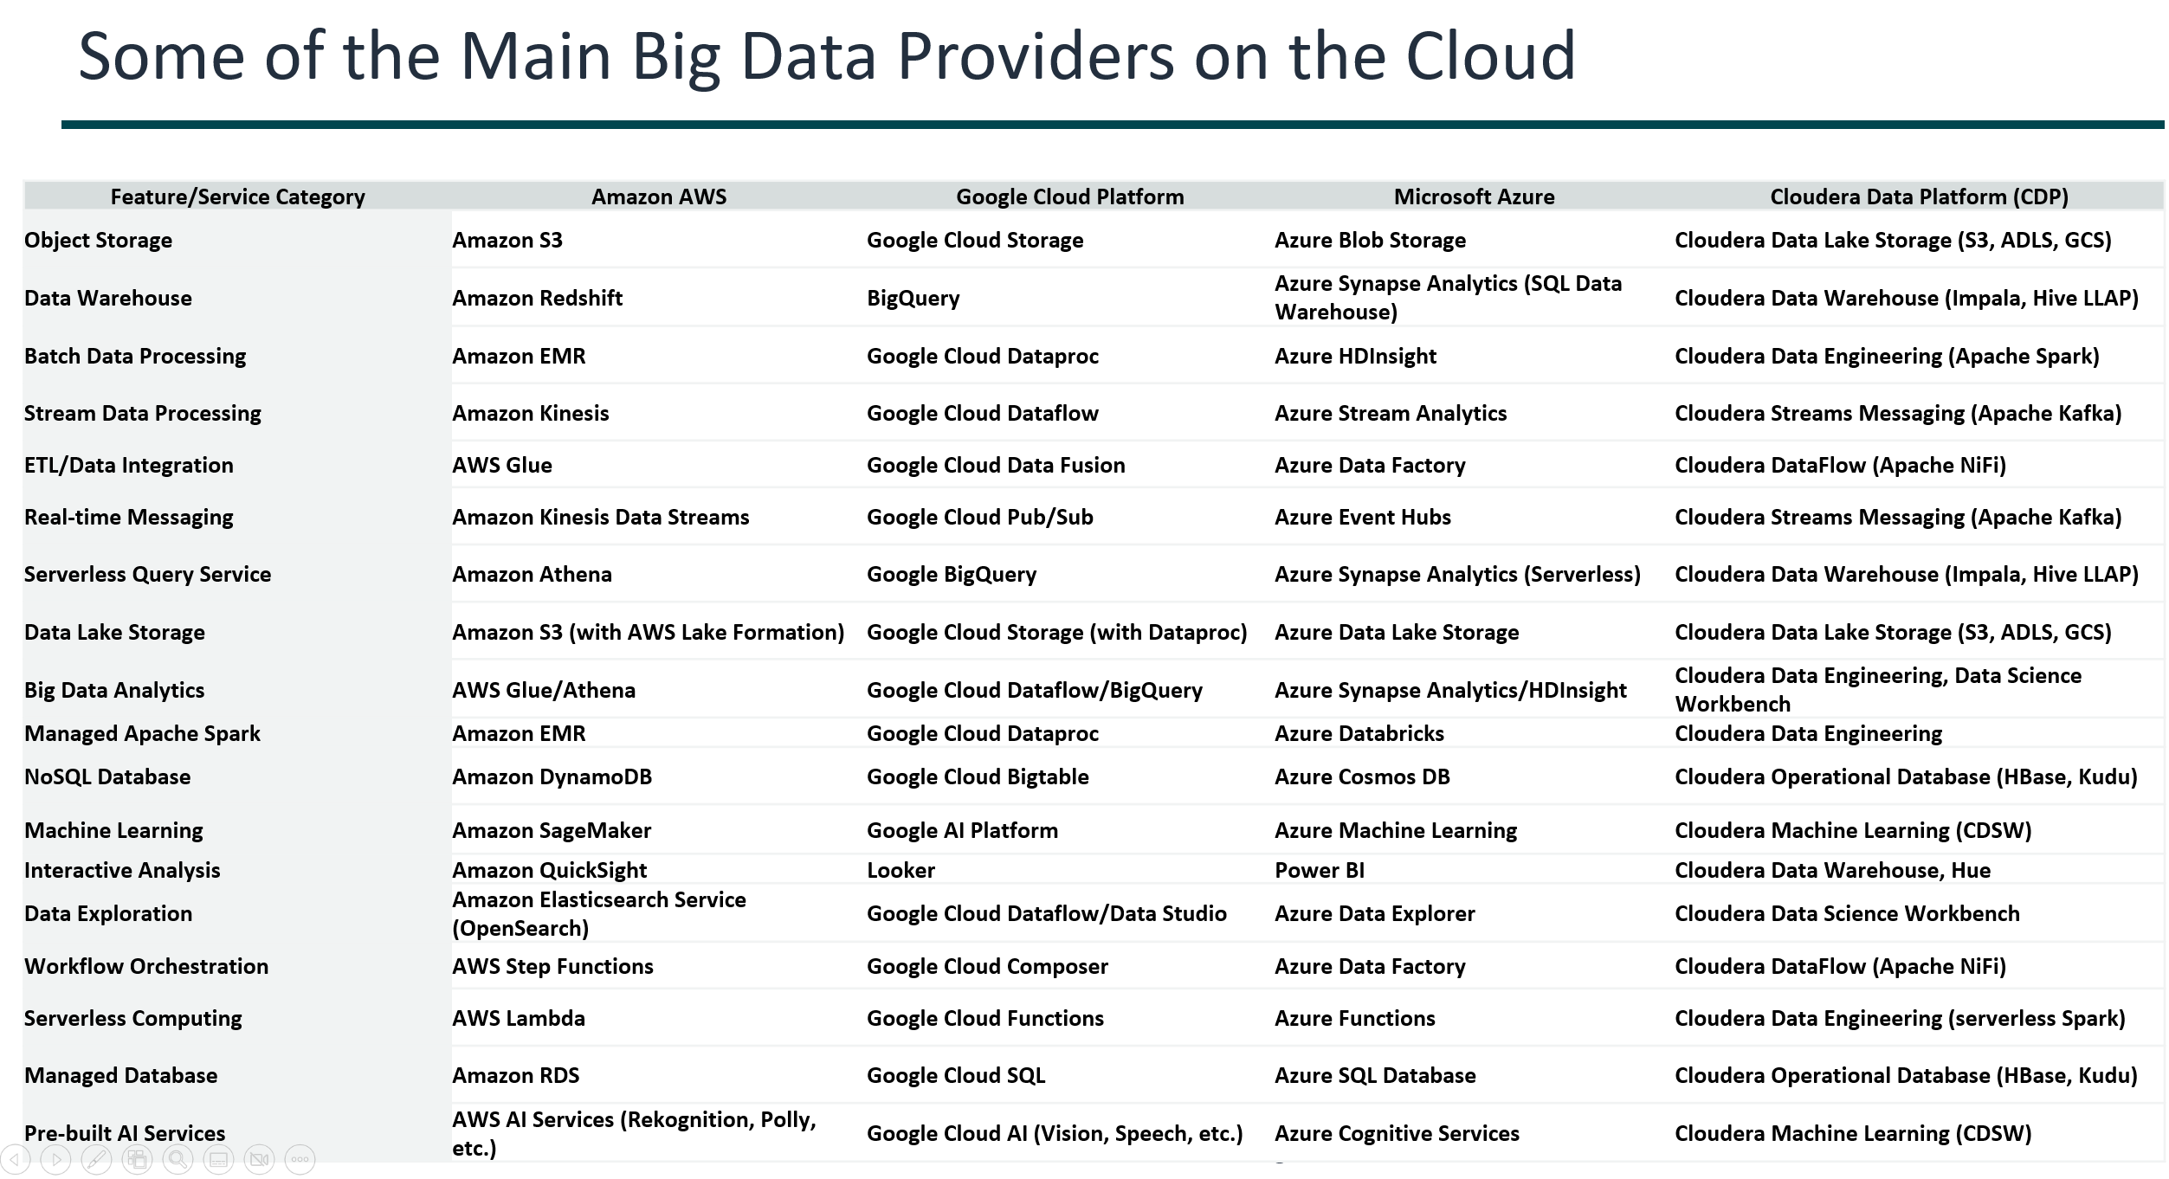
Some of the Main Big Data Providers on the Cloud
Feature/Service Category | Amazon AWS | Google Cloud Platform | Microsoft Azure | Cloudera Data Platform (CDP)
Object Storage | Amazon S3 | Google Cloud Storage | Azure Blob Storage | Cloudera Data Lake Storage (S3, ADLS, GCS)
Data Warehouse | Amazon Redshift | BigQuery | Azure Synapse Analytics (SQL Data Warehouse) | Cloudera Data Warehouse (Impala, Hive LLAP)
Batch Data Processing | Amazon EMR | Google Cloud Dataproc | Azure HDInsight | Cloudera Data Engineering (Apache Spark)
Stream Data Processing | Amazon Kinesis | Google Cloud Dataflow | Azure Stream Analytics | Cloudera Streams Messaging (Apache Kafka)
ETL/Data Integration | AWS Glue | Google Cloud Data Fusion | Azure Data Factory | Cloudera DataFlow (Apache NiFi)
Real-time Messaging | Amazon Kinesis Data Streams | Google Cloud Pub/Sub | Azure Event Hubs | Cloudera Streams Messaging (Apache Kafka)
Serverless Query Service | Amazon Athena | Google BigQuery | Azure Synapse Analytics (Serverless) | Cloudera Data Warehouse (Impala, Hive LLAP)
Data Lake Storage | Amazon S3 (with AWS Lake Formation) | Google Cloud Storage (with Dataproc) | Azure Data Lake Storage | Cloudera Data Lake Storage (S3, ADLS, GCS)
Big Data Analytics | AWS Glue/Athena | Google Cloud Dataflow/BigQuery | Azure Synapse Analytics/HDInsight | Cloudera Data Engineering, Data Science Workbench
Managed Apache Spark | Amazon EMR | Google Cloud Dataproc | Azure Databricks | Cloudera Data Engineering
NoSQL Database | Amazon DynamoDB | Google Cloud Bigtable | Azure Cosmos DB | Cloudera Operational Database (HBase, Kudu)
Machine Learning | Amazon SageMaker | Google AI Platform | Azure Machine Learning | Cloudera Machine Learning (CDSW)
Interactive Analysis | Amazon QuickSight | Looker | Power BI | Cloudera Data Warehouse, Hue
Data Exploration | Amazon Elasticsearch Service (OpenSearch) | Google Cloud Dataflow/Data Studio | Azure Data Explorer | Cloudera Data Science Workbench
Workflow Orchestration | AWS Step Functions | Google Cloud Composer | Azure Data Factory | Cloudera DataFlow (Apache NiFi)
Serverless Computing | AWS Lambda | Google Cloud Functions | Azure Functions | Cloudera Data Engineering (serverless Spark)
Managed Database | Amazon RDS | Google Cloud SQL | Azure SQL Database | Cloudera Operational Database (HBase, Kudu)
Pre-built AI Services | AWS AI Services (Rekognition, Polly, etc.) | Google Cloud AI (Vision, Speech, etc.) | Azure Cognitive Services | Cloudera Machine Learning (CDSW)

